Slide 1


APEX Ethernet Network Diagrams
Examples of approved and unapproved Network combinations
February 19, 2021

Slide 2
General Notes
Humminbird uses AutoIP with a Switch rather than DHCP with a Router.
Because of this the following is not allowed:
No Loops
No Multi-Paths
No more than four control heads in any network
(with or without a Switch)
No more than three Ethernet switches
No duplicate Ethernet Accessories
(except for SM1000, 2000, 3000)

Slide 3

Approved Network Set Up Examples
This is only a sampling of possible combinations.
Accessories are not limited to those shown in
these examples.
If you would like a sample network reviewed,
send a wiring diagram to
humminbirdselect@humminbird.com

Slide 4

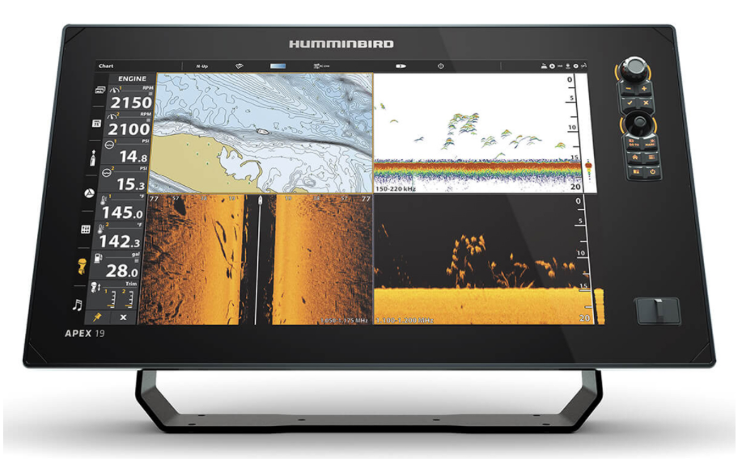


One Unit
No Ethernet Switch
Two Ethernet Accessories

Slide 5

Two Units
No Ethernet Switch
Two Ethernet Accessories

Slide 6
Four Units
No Ethernet Switch
Two Ethernet Accessories

Slide 7
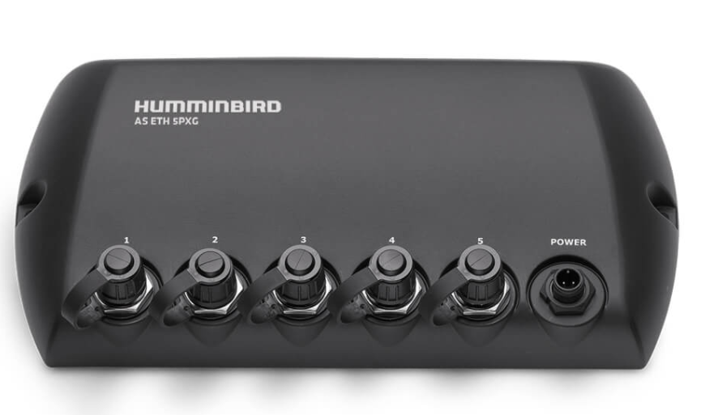
Four Units
One Ethernet Switch
One Ethernet Accessory

Slide 8
Four Units
Two Ethernet Switches
Two Ethernet Accessories

Slide 9
Four Units
Two Ethernet Switches
Two Ethernet Accessories

Slide 10

Network Set Ups
Not Recommended
The following is a setup that is technologically acceptable. But it is not recommended from a logistical/usability perspective.
We offer two other recommended solutions

Slide 11
Less favorable setup
Four Units
One Ethernet Switch
Two Ethernet Accessories
The RADAR (Ethernet Accessory) should be connected to the Ethernet Switch

Slide 12
Preferred Set Up - 1
Four Units
Two Ethernet Switches
Two Ethernet Accessories

Slide 13
Preferred Set Up - 2
Four Units
One Ethernet Switches
Two Ethernet Accessories

Slide 14

Unapproved Network
Set Up Examples
Humminbird uses AutoIP with a Switch rather than DHCP with a Router. Because of this: Loops and Multi-paths are not allowed and will not work.
If you would like a sample network reviewed,
send a wiring diagram to
humminbirdselect@humminbird.com

Slide 15

Multi-Path Definition & Examples
Multi-pathing is the technique of creating more than one physical path between a server and its storage devices. In the correct application it can result in better fault tolerance and performance enhancement.
Because Humminbird uses AutoIP, the result is poor performance of the network.

Slide 16
One Multi-Path in the network
2 units
No Switches
No Ethernet Accessories

Slide 17
One Multi-Path in a network
4 units
2 Switches
2 Ethernet Accessories

Slide 18
Two Multi-Paths in one network
4 units
1 switch
2 ethernet accessories
Multi-Path 1
Multi-Path 2

Slide 19
Loop Definition & Examples
A switching loop or bridge loop occurs in computer networks when there is more than one Layer 2 (OSI model) path between two endpoints (e.g. multiple connections between two network switches or two ports on the same switch connected to each other)

Slide 20
Single loop in one network

Slide 21
Two loops in one network
Loop 2
Loop 1

